Slide 1
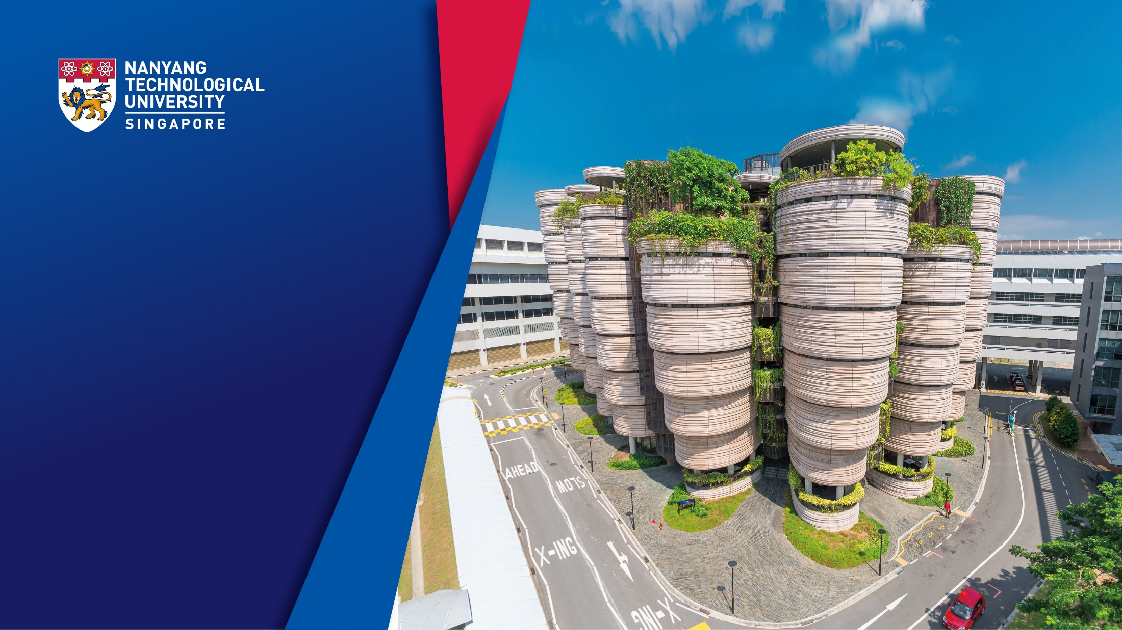







Beating Quantum Computing through Classical Attacks
2nd Annual Quantum Computer Cybersecurity Symposium
QCCS 2024. Oct 25, 2024
Authors
Siyi Wang, Alex Jin, Suman Deb, Tarun Dutta, Manas Mukherjee, and Anupam Chattopadhyay
Email
Siyi002@e.ntu.edu.sg

Slide 2
01 Introduction
02 Research Gap
03 Contribution
04 Method
05 Results
06 Conclusion
CONTENT

Slide 3

1. Introduction: What is Malware?
Malware is a special type of software designed to cause damage to a computer system.
It remains a hot topic in the cybersecurity community^{[2][3][4][5]}.

Slide 4
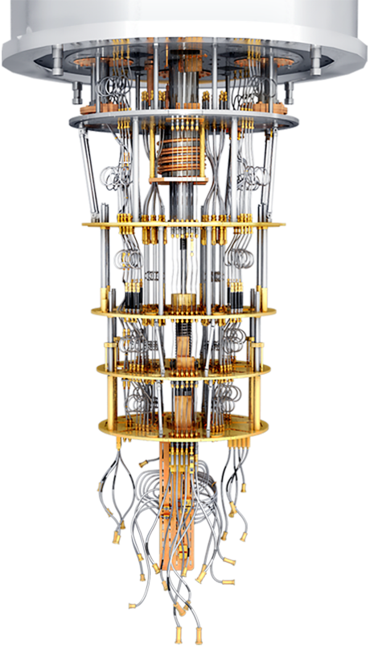



2. Research Gap: Malware for Quantum Computers?
Quantum computers are set to revolutionize multiple application domains by offering algorithmic speed-up over the best-known classical algorithms.
Quantum Computer
Finance
Drug Discovery
Cryptography
The technological revolution ushered in by quantum computers has garnered widespread attention, rendering quantum machines the likely targets of cyber attacks.
However......
The few works available demonstrate only information leakage through side channel attacks on quantum cloud-based computers^{[6][7][8]}.

Slide 5
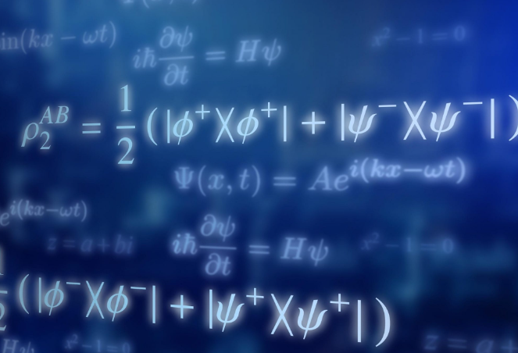

3. Contribution
To date, no documented attack has successfully achieved direct control over a quantum computer.
We successfully overcame these challenges, culminating in the development of the first malware targeting quantum computers.
Challenge 1: The complex and unique nature of quantum systems.
Challenge 2: Gap between quantum and cybersecurity

Slide 6
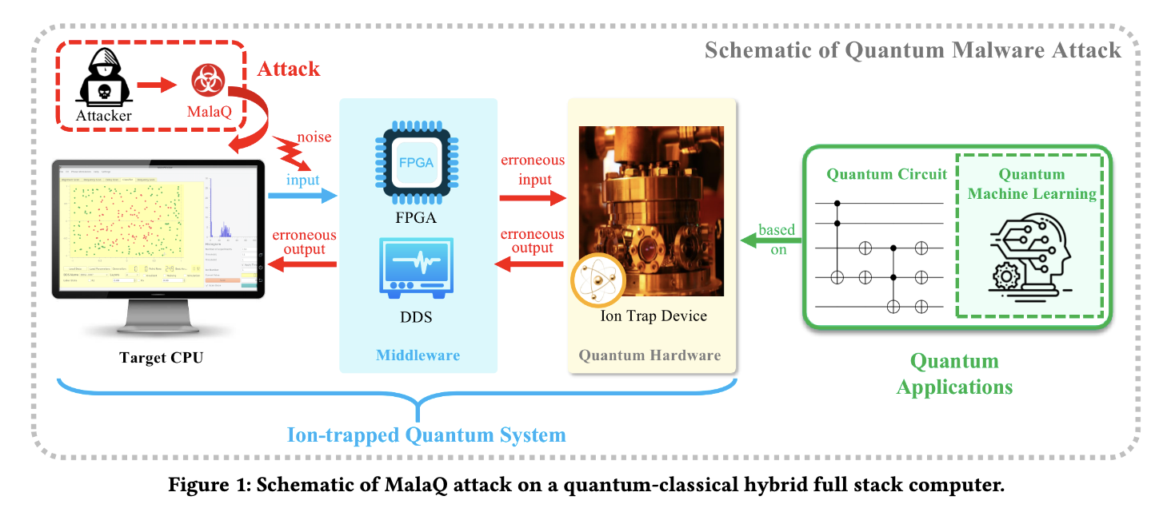
4. Methodology: Attack Workflow

Slide 7

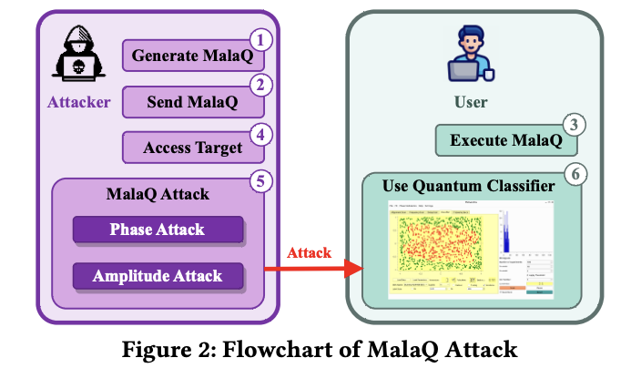

4. Methodology: Breakdown of the Attack
Step1: Design and program a reverse TCP-based malware
Step 3: Execution MalaQ on the target CPU
Step 2: Delivery MalaQ to the target CPU
Attacked！
Step 4: Access to the target system.
Step 6: Run the erronerous quantum application.
Step 5: Attack on quantum classifier.

Slide 8
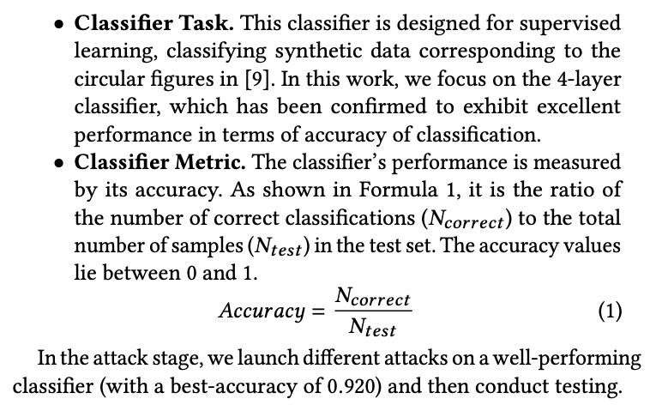
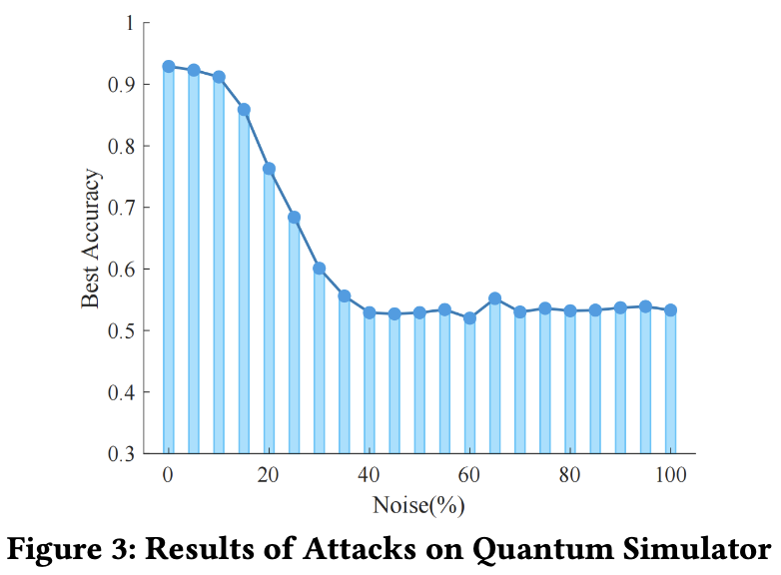
5. Results: Quantum Simulator
Lowest Accuracy

Slide 9
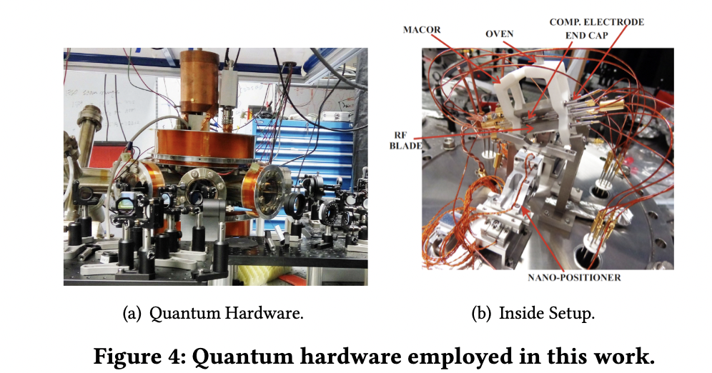

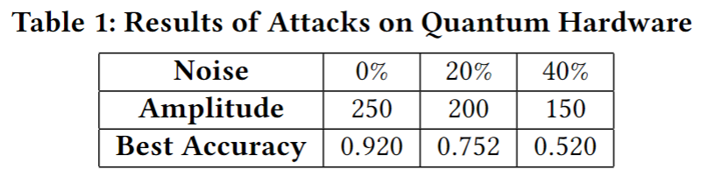

5. Results: Quantum Hardware
Here, we utilized a real Noisy Intermediate-Scale Quantum (NISQ) device.
Very Expensive......
Classifier Accuracy
Reliability of Quantum Hardware
Didn’t Destory the Quantum Device

Slide 10
6. Conclusion
In this paper, we introduced MalaQ^{[1]}, a novel malware targeting vulnerabilities in quantum-classical hybrid computing systems.
Infiltrates classical control systems, manipulating quantum circuits and causing performance degradation or complete failure.
First demonstration of classical malware threatening quantum computers, highlighting the need for stronger defense strategies.
Future directions
Focus on attacks targeting control systems to tamper with scripts/ memory.
Explore quantum ransomware through malicious encryption of quantum measurements.
......

Slide 11


6. Conclusion: Why MalaQ?
Mala
Quantum
MALAQ
MALware Attacks Quantum
+
=

Slide 12

Q&A Thank you for listening!
2nd Annual Quantum Computer Cybersecurity Symposium
QCCS 2024. Oct 25, 2024
Email: siyi002@e.ntu.edu.sg
Manuscript

Slide 13
References
[1] Wang, Siyi, Alex Jin, Suman Deb, Tarun Dutta, Manas Mukherjee, and Anupam Chattopadhyay. "POSTER: MalaQ-A Malware Against Quantum Computer." In Proceedings of the 19th ACM Asia Conference on Computer and Communications Security, pp. 1946-1948. 2024.
[2] John Neumann. 1996. The Theory of Self-Reproducing Automata. http://www.walenz.org/vonNeumann/ (01 1996).
[3] Maria Prevezianou. 2021. WannaCry as a Creeping Crisis. 37–50. https://doi.org/10.1007/978-3-030-70692-0_3
[4] Jun Gao, Li Li, Pingfan Kong, Tegawendé Bissyandé, and Jacques Klein. 2019. Should You Consider Adware as Malware in Your Study? 604–608. https://doi.org/10.1109/SANER.2019.8668010
[5] Yassine Mekdad, Giuseppe Bernieri, Mauro Conti, and Abdeslam El Fergougui.
2022. The Rise of ICS Malware: A Comparative Analysis. 496–511. https://doi.org/
10.1007/978-3-030-95484-0_29

Slide 14
References
[6] Chao Lu, Esha Telang, Aydin Aysu, and Kanad Basu. 2024. Quantum Leak: Timing
Side-Channel Attacks on Cloud-Based Quantum Services. ArXiv abs/2401.01521(2024). https://api.semanticscholar.org/CorpusID:266741571
[7] Chuanqi Xu, Ferhat Erata, and Jakub Szefer. 2023. Exploration of Power Side Channel Vulnerabilities in Quantum Computer Controllers. 579–593. https://doi.org/10.1145/3576915.3623118
[8] Brennan Bell and Andreas Trugler. 2022. Reconstructing quantum circuits through side-channel information on cloud-based superconducting quantum computers. 259–264. https://doi.org/10.1109/QCE53715.2022.00045
[9] Pérez-Salinas, Adrián, Alba Cervera-Lierta, Elies Gil-Fuster, and José I. Latorre. "Data re-uploading for a universal quantum classifier." Quantum 4 (2020): 226.

